Slide 1
ENSE 470: Milestone 5
Team Dancing to Zebras
Tristan Heisler, Demitri Kourles and Zuoxiu Xing
March 15th, 2018

Slide 2
Acceptance Test-Driven Development
These acceptance tests describe the higher level features and functionality that the client expects from the software.
We chose to develop these tests for both the Minimum Viable Product and Release 2 as we believe this allows us to better understand the overall expectations of the system and implement a more upgradable design.
In total, our 19 user stories resulted in 34 scenarios outlining our acceptance tests.

Slide 3
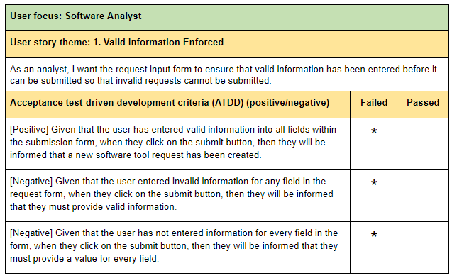
ATDD Test Cases

Slide 4
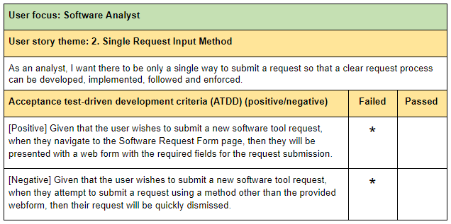
ATDD Test Cases

Slide 5
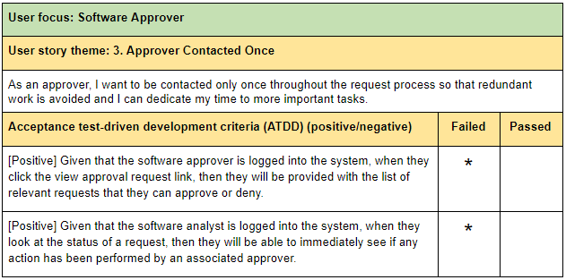
ATDD Test Cases

Slide 6
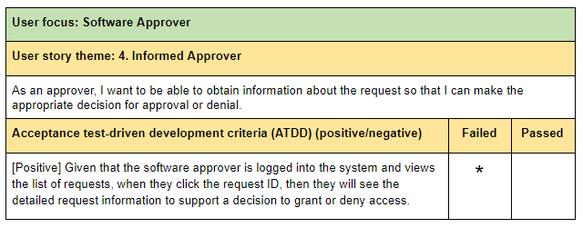
ATDD Test Cases

Slide 7
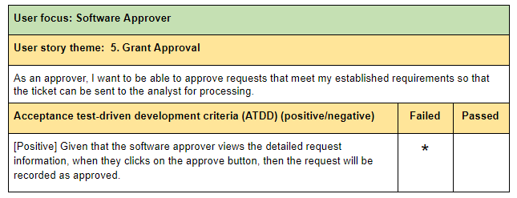
ATDD Test Cases

Slide 8
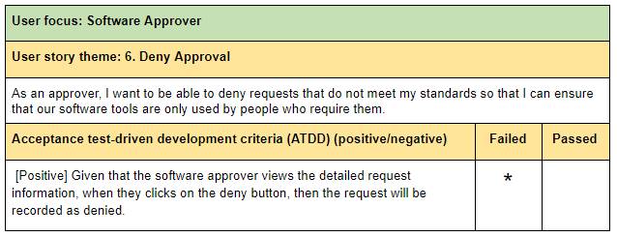
ATDD Test Cases

Slide 9
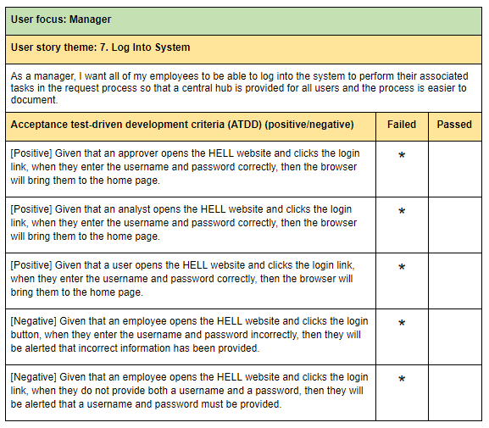
ATDD Test Cases

Slide 10
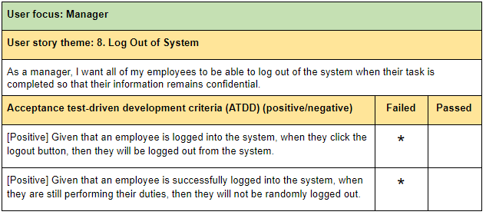
ATDD Test Cases

Slide 11
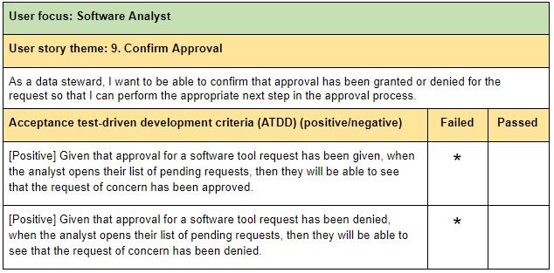
ATDD Test Cases

Slide 12
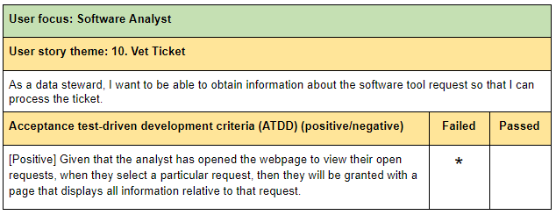
ATDD Test Cases

Slide 13
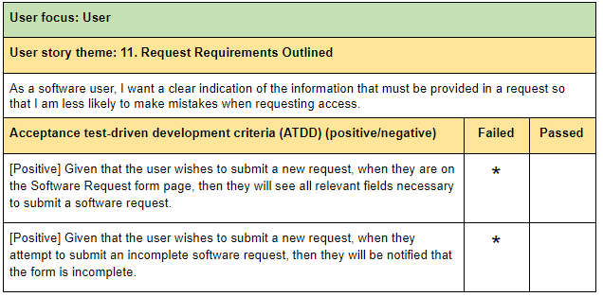
ATDD Test Cases

Slide 14
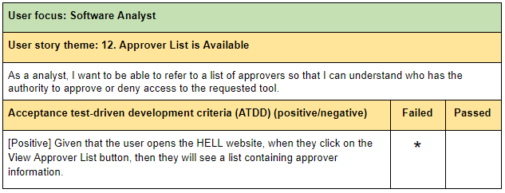
ATDD Test Cases

Slide 15
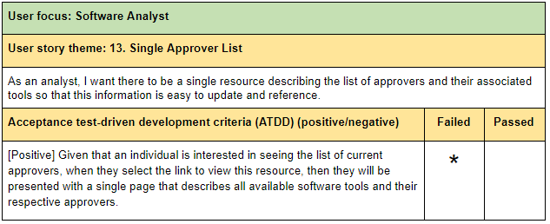
ATDD Test Cases

Slide 16
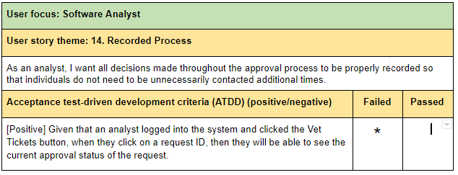
ATDD Test Cases

Slide 17
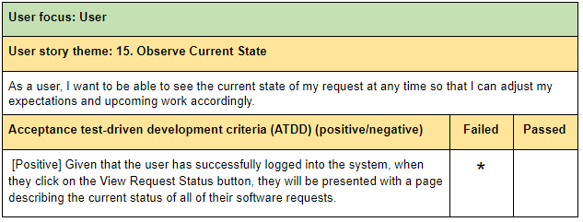
ATDD Test Cases

Slide 18
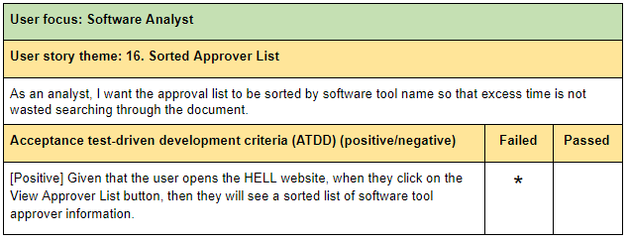
ATDD Test Cases

Slide 19
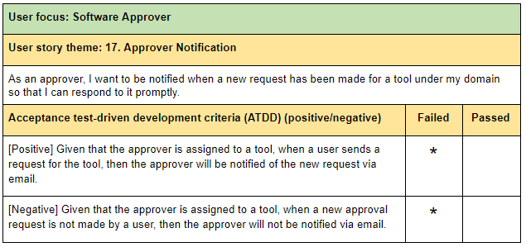
ATDD Test Cases

Slide 20
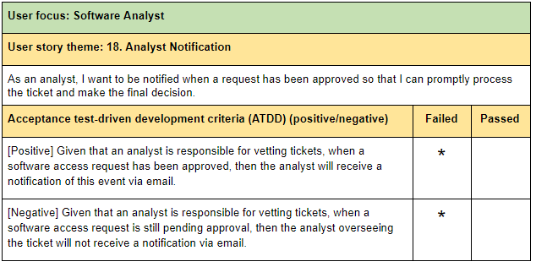
ATDD Test Cases

Slide 21
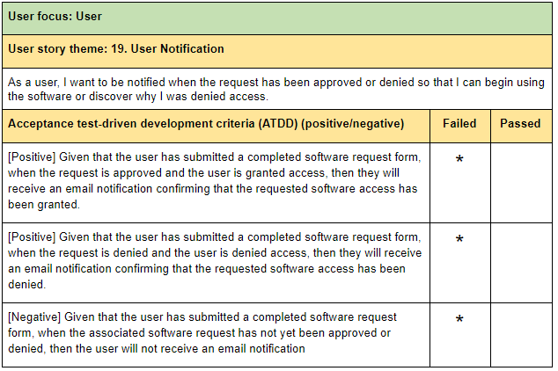
ATDD Test Cases

Slide 22
ATDD Experience
Did this activity change/add anything to your proposed design/plans?
This activity allowed us to improve the robustness of our system by determining how the system should react if the user interacts with the system in an unexpected way.
Do you envision any possible gaps in testing (i.e. unit, etc.)?
Acceptance testing is focused on the high-level functionality of the system. As such, it is a form of black box testing that does not necessarily consider how the system is implemented and may miss low level details that could be caught in unit/integration tests.
Would it have helped to do this activity pre-Lo-Fi prototyping?
We enjoyed having our Lo-Fi prototypes in front of us when developing our acceptance tests as it the presence of mockups allowed us to better see potential ways for the user to interact with the system.
A visual representation of our system greatly aided us when beginning to actually implement the features outlined in the Minimum Viable Product.

Slide 23
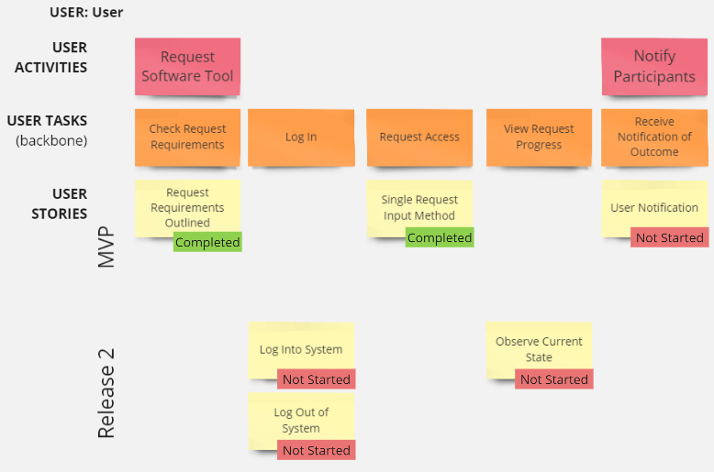
“Daily” Scrum

Slide 24
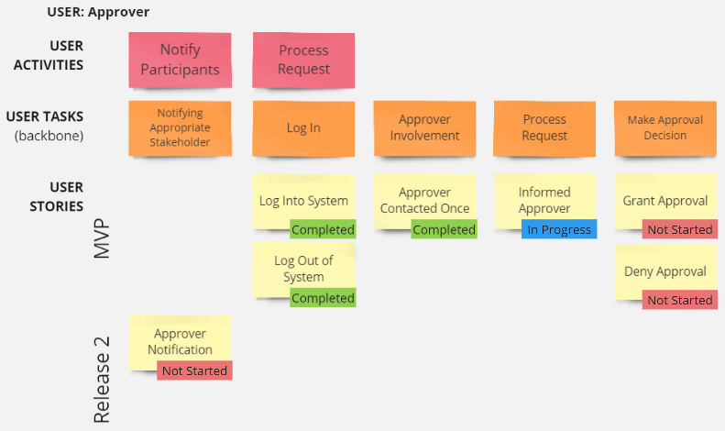
“Daily” Scrum

Slide 25
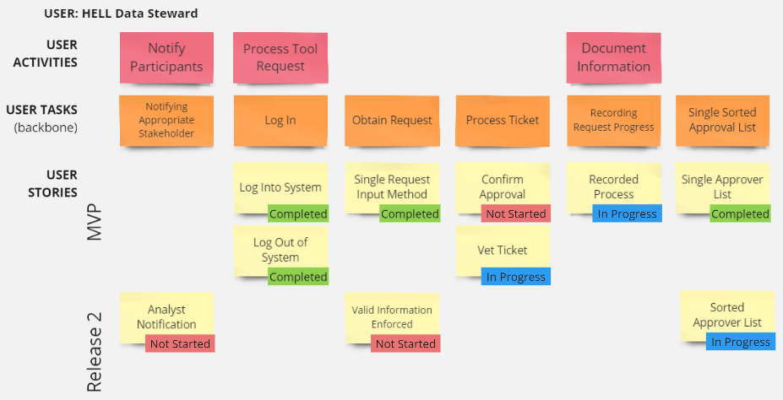
“Daily” Scrum

Slide 26
“Daily” Scrum
Are you on track?
Yes. So far, we have implemented the ability to log in, log out, view the approver list and reach the request submission page. We have also ensured that only a single method of submission exists and that the approver is only contacted once.
By the end of the sprint (Milestone 6), we will have implemented the remaining features for the MVP, such as the ability to approve/deny requests for the approver/analyst and to notify the user once a decision is made.
Any barriers to your group’s success?
We have found it slightly difficult to develop web files as a team.
Do you envision being able to achieve more (or less) for your MVP?
We believe we will be able to achieve more. Some features originally intended for Release 2 may be ready for the Minimum Viable Product.

Slide 27
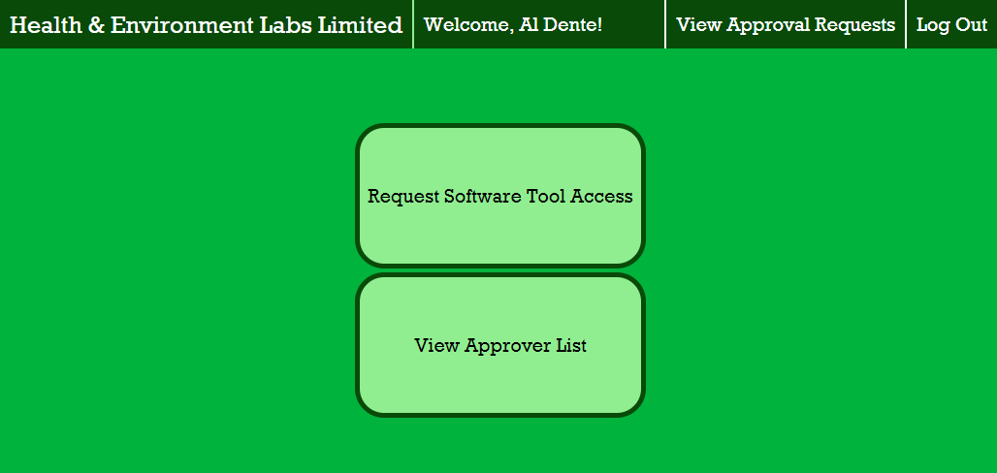
Current Development Snapshots

Slide 28
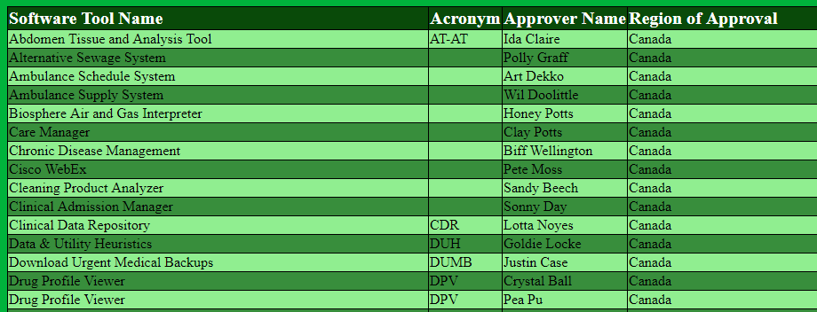
Current Development Snapshots

Slide 29
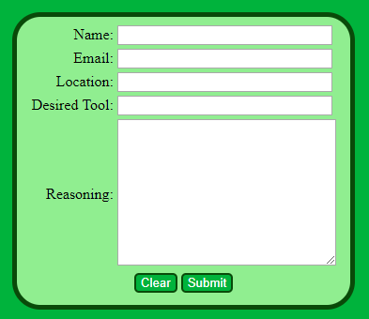
Current Development Snapshots

Slide 30
Changes
Have your plans changed since your group’s initial conception and project evolution?
No major changes have been implemented since Milestone 4. However, we believe we will be able to develop some features from release 2 earlier.
Additional functionality suggested by the client (such as the ability to display a certain amount of requests per page) can be added to the product backlog to be implemented within a future release.

Slide 31
Group Reflection
How did you feel about this milestone? What did you like about it? What did you dislike?
We liked being able to use our previously developed User Story Maps as a way to record our process. We also enjoyed considering how a user could potentially interact with the system unexpectedly.
What did you learn about yourself as you collaborated and worked through this milestone?
It was reinforced that different members of the team offer different insights and suggestions. Some of our ATDD tests would not have existed without the input of all group members.
How will you use what you have learned going forward?
Within this project, we will use the ATDD tests to ensure that our project meets the requirements of the MVP. In the real world, we could develop and analyze these test cases alongside the client to determine the conditions under which they would accept the software.
What “stuff & things” related to this milestone would you want help with?
It was difficult determining potential negative scenarios for some user stories.

Slide 32
Questions?

